Slide 1
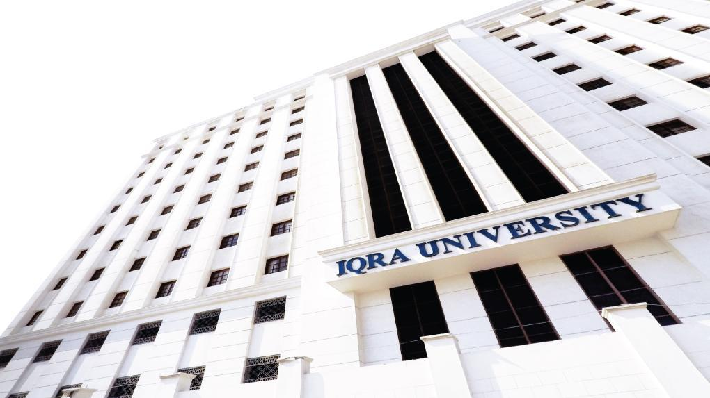

Software Quality Assurance
Software Development Life Cycle
Presented by
Shumail Zehra

Slide 2
Welcome!!

Slide 3
Content
Software Development Life Cycle
Quality Assurance
Capability Maturity Model Integration

Slide 4
SOFTWARE DEVELOPMENT LIFE CYCLE

Slide 5
What is sdlc?
Software Development Life Cycle (SDLC) is a framework that defines the steps involved in the development of software at each phase. It covers the detailed plan for building, deploying and maintaining the software.
SDLC defines the complete cycle of development i.e. all the tasks involved in planning, creating, testing, and deploying a Software Product.
Purpose of SDLC is to deliver a high-quality product which is as per the customer’s requirement.
SDLC has defined its phases as, Requirement gathering, Designing, Coding, Testing, and Maintenance. It is important to adhere to the phases to provide the Product in a systematic manner.

Slide 6
Phases
Requirement gathering and analysis
Design
Implementation or coding
Testing
Deployment
Maintenance

Slide 7
Requirement Gathering and Analysis
During this phase, all the relevant information is collected from the customer to develop a product as per their expectation. Any ambiguities must be resolved in this phase only.
Business analyst and Project Manager set up a meeting with the customer to gather all the information like what the customer wants to build, who will be the end-user, what is the purpose of the product. Before building a product a core understanding or knowledge of the product is very important.

Slide 8
Design/Define requirements
In this phase, the requirement gathered in the SRS document is used as an input and software architecture that is used for implementing system development is derived.
Implementation or Coding
Implementation/Coding starts once the developer gets the Design document. The Software design is translated into source code. All the components of the software are implemented in this phase.

Slide 9
Testing
Testing starts once the coding is complete and the modules are released for testing. In this phase, the developed software is tested thoroughly and any defects found are assigned to developers to get them fixed.
Retesting, regression testing is done until the point at which the software is as per the customer’s expectation. Testers refer SRS document to make sure that the software is as per the customer’s standard.

Slide 10
Deployment
Once the product is tested, it is deployed in the production environment or first UAT (User Acceptance testing) is done depending on the customer expectation.
In the case of UAT, a replica of the production environment is created and the customer along with the developers does the testing. If the customer finds the application as expected, then sign off is provided by the customer to go live.

Slide 11
Maintenance
After the deployment of a product on the production environment, maintenance of the product i.e. if any issue comes up and needs to be fixed or any enhancement is to be done is taken care by the developers.

Slide 12
CAPABILITY MATURITY MODEL INTEGRATION

Slide 13
CMMI Capability Maturity Model Integration
Capability Maturity Model Integration (CMMI) is a process level improvement training and appraisal program. Administered by the CMMI Institute.
Provides guidance on how to gain control of processes for developing and maintaining software and how to evolve toward a culture of software engineering and management excellence.
CMMI has certain levels defined:
Level 0: Incomplete
Level 1: Performed

Slide 14
Level 2: Managed
Level 3: Defined
Level 4: Quantitatively Managed
Level 5: Optimized

Slide 15
Maturity Level 0 deals is incomplete.
Maturity Level 1 deals with performed processes.
Processes are unpredictable, poorly controlled, and reactive.
The process performance may not be stable and may not meet specific objectives such as quality, cost, and schedule, but useful work can be done.

Slide 16
Maturity Level 2 deals with managed processes.
A managed process is a performed process that is also:
Planned and executed in accordance with policy
Employs skilled people
Adequate resources are available
Controlled outputs are produced
Stakeholders are involved
The process is reviewed and evaluated for adherence to requirements

Slide 17
Processes are planned, documented, performed, monitored, and controlled at the project level. Often reactive.
The managed process comes closer to achieving the specific objectives such as quality, cost, and schedule.

Slide 18
Maturity Level 3 deals with defined processes.
A defined process is a managed process that:
Well defined, understood, deployed and executed across the entire organization. Proactive.
Processes, standards, procedures, tools, etc. are defined at the organizational (Organization X) level. Project or local tailoring is allowed, however it must be based on the organization’s set of standard processes and defined per the organization’s tailoring guidelines.
Major portions of the organization cannot “opt out.”

Slide 19
Maturity Level 4 is quantitatively managed.
All level 3 criteria have been achieved.
The process area is controlled and improved.
Quality is being maintained.
Maturity Level 5 deals with optimization.
Continuous process improvement is enabled by quantitative feedback from the process and from piloting innovative ideas and technologies.

Slide 20
Review Question
How important is Quality Assurance for a software being developed?
In which phase of SDLC is Quality Assurance done?
Integrating Quality Assurance in a software being developed will achieve which level of CMMI?

Slide 21
Online Resources
https://www.youtube.com/watch?time_continue=1&v=i-QyW8D3ei0&feature=emb_logo
https://www.youtube.com/watch?v=SfC7BPwyY1g&t=174s
A Research Study on importance of Testing and Quality Assurance in Software Development Life Cycle (SDLC) Models by Maneela Tuteja, Gaurav Dubey

Slide 22
Thank you

